Slide 1
PLAYSTORE APP REVIEW ANALYSIS
NAAN MUDHALVAN PROJECT
Presented By:
1. Manikandan B-Surya Engineering College-Mechanical Engineering

Slide 2
OUTLINE
Problem Statement
Proposed System/Solution
System Development Approach
Algorithm & Deployment
Result
Conclusion
Future Scope
References

Slide 3
Problem Statement
The Play Store apps data has enormous potential to drive app-making businesses to success. Actionable insights can be drawn for developers to work on and capture the Android market. Each app (row) has values for category, rating, size, and more. Another dataset contains customer reviews of the android apps. Explore and analyses the data to discover key factors responsible for app engagement and success.

Slide 4
Proposed Solution
Using advanced machine learning algorithms, our solution will analyse extensive historical values for category, rating, size, and more.
Percentage of apps that are top rated = ~80%
For optimal timing, a predictive model will consider main factor as season for apps ( e.g. In summer the games are mostly downloaded app, In feb month the dating apps are going trend )
Category with the highest average app installs: Game
There are 20 free apps that have been installed over a billion time. Mine craft is the only app in the paid category with over 10M installs. This app has also produced the most revenue only from the installation fee.

Slide 5
System Approach
Building the proposed solution would involve a combination of data processing, feature engineering, and machine learning. Here are the key system and library requirements:
System Requirements:
Hardware:
-A computer with sufficient processing power, preferably with multiple cores or a GPU for faster training of machine learning models.
Software:
-An operating system compatible with the required machine learning libraries(e.g. Windows, Linux, macOS)

Slide 6
System Approach cont.
Library Requirements:
1. Data Processing and Analysis:
-Pandas: For data manipulation and analysis.
-NumPy: For numerical operation on data.
2. Data Visualization:
-Matplotlip and seaborn: For creating visualization to understand the pattern

Slide 7
Algorithm & Deployment
The dataset contains the Google Play Store Apps data taken from kaggle.com - We'll analyses this data to bring out some useful insights of the App usage and the future markets for potentials apps. The Play Store apps data has enormous potential to drive app-making businesses to success. Actionable insights can be drawn for developers to work on and capture the Android market! We are using python libraries pandas and numpy to get these useful analysis done. This project is completed with help of the training completed through the course Data Analysis with Python: Zero to Pandas, The course helped in understanding the Python and its various libraries to get the data analyses done easily.

Slide 8
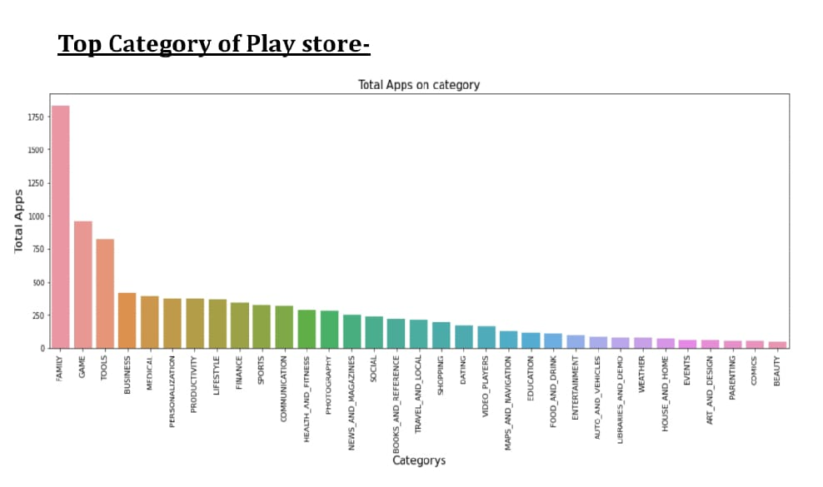
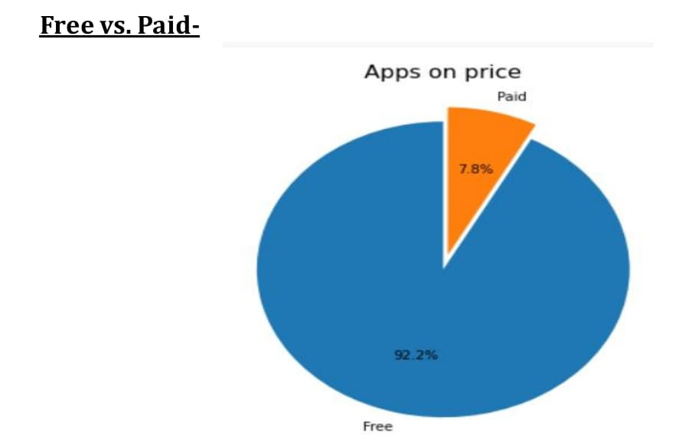
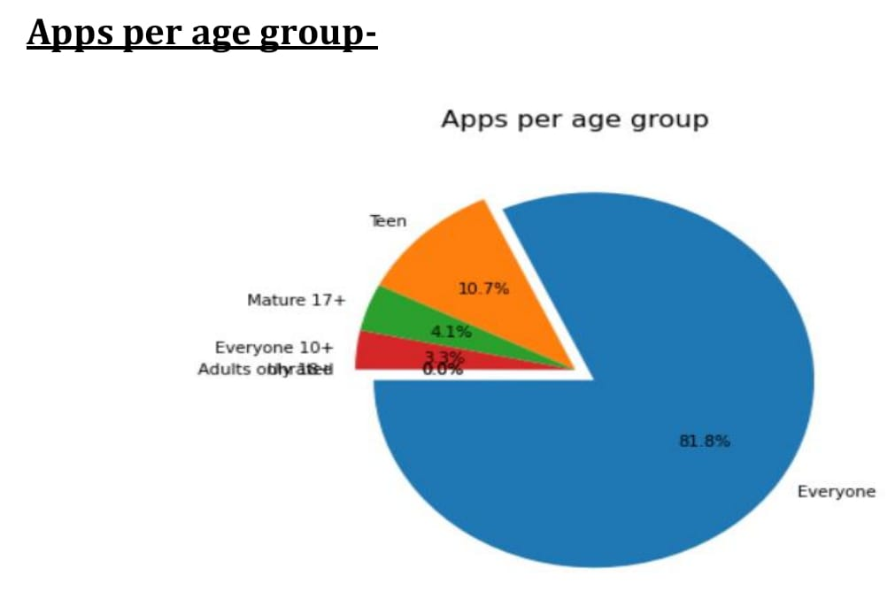
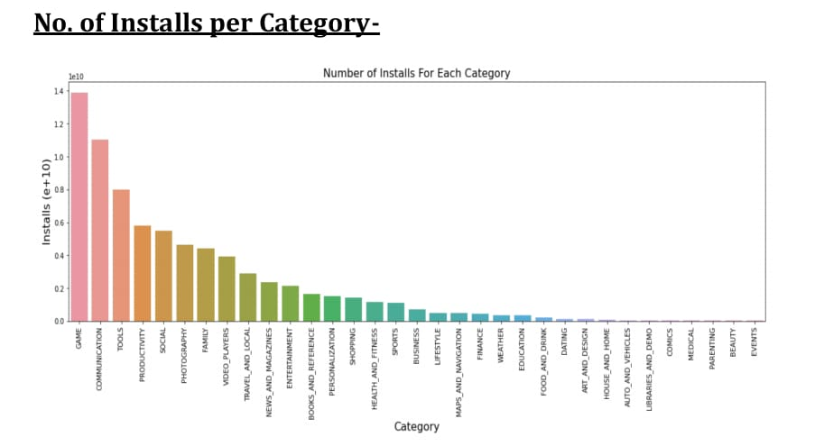
Result

Slide 9
Conclusion
Through exploratory data analysis we have observed some trends and have made some assumptions that might lead to app success among the users in the play store.
The Google Play Store Apps report provides some useful insights regarding the trending of the apps in the play store. As per the graphs visualizations shown above, most of the trending apps (in terms of users' installs) are from the categories like GAME, COMMUNICATION, and TOOL even though the amount of available apps from these categories are twice as much lesser than the category FAMILY

Slide 10
Future scope
The proposed solution lays the foundation for ongoing advancement in the data to discover key factors responsible for app engagement and success.
Personalization and Customization:
Enhance the predictive models to offer more personalized recommendation by considering individual app preference, user details security, and user specific requirements, and more customizations in apps.

Slide 11
References
https://pandas.pydata.org/pandas-docs/stable/user
https://www.kaggle.com/datasets
https://matplotlib.org/stable/contents.html
https://seaborn.pydata.org/

Slide 12
THANK YOU

